Slide 1


IBM Employee Attrition Analysis
An analysis of employee attrition at IBM, with data-driven strategies for retention.
Sushant Kumar

Slide 2
Understanding Employee Attrition
The Challenge
Why It Matters
Presentation Overview
Employee attrition poses a significant challenge for IBM.
Analyzing attrition helps reduce costs and boost morale.
We outline our objectives and approach to attrition analysis.
Understanding why employees leave is vital.

Slide 3




Problem Statement: Addressing Attrition
High Attrition Rates
Need for Data Insights
IBM faces high attrition rates compared to the industry average.
Data-driven insights are crucial for addressing attrition effectively.
Key Questions
What factors drive attrition? How can we identify them?

Slide 4
DATASET INFORMATION
Realtime Dataset
No. of Rows – 50,000
No. of Columns - 37

Slide 5

Methodology: Data-Driven Approach
Data Collection
Gathering and cleaning data from various sources.
Analytical Techniques
Applying statistical analysis
Tools Used
Utilizing Excel Graphs, KPI’s, Pivot tables

Slide 6

Workforce Overview
50K
49%
Employees
Attrition Rate
Total active employees.
Overall percentage of employees who left.
5
Years
Average tenure across the workforce.

Slide 7
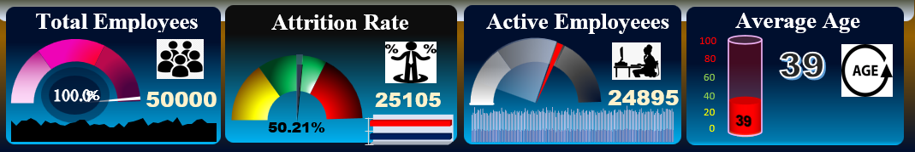
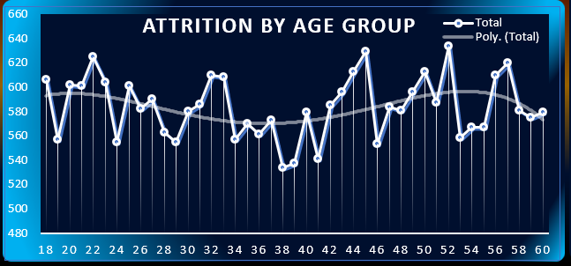
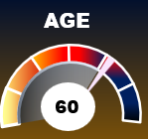
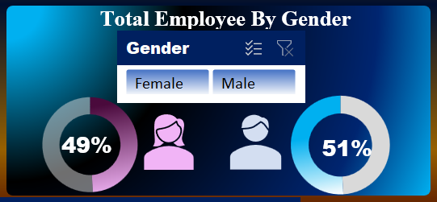
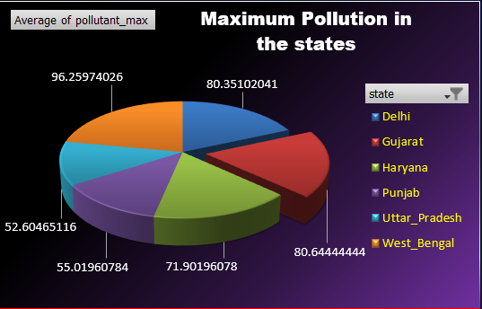
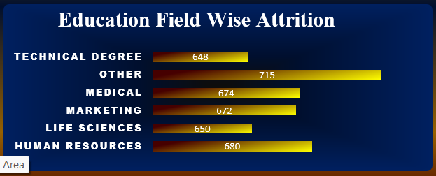
OBJECTIVES ARCHIVED
Total Workforce Overview
Analyze age distribution and its impact on attrition.
Understand employee gender ratio.
Measure attrition across education backgrounds.
Assess department-specific attrition trends.

Slide 8
OBJECTIVES ARCHIVED
Examine attrition counts by job roles.
Check correlation between salary and experience.
Determine if frequent travel impacts attrition.
Evaluate attrition by marital status.
Understand satisfaction's effect on attrition.

Slide 9




Age and Gender Analysis
Age-Based
Attrition rates vary by age group.
Gender-Based
Attrition rates differ by gender.
Vulnerable Demographics
Identifying groups at higher risk.

Slide 10



Attrition by Education and Department
High-Risk Departments
2
Identifying departments with high attrition rates.
Education Field
1
Attrition trends based on educational background.
Actions to Reduce
Implementing strategies to mitigate attrition.
3

Slide 11




Job Role and Work-Life Balance
Job Role
Attrition by specific job functions.
Work-Life Balance
Relationship between attrition and work-life balance.
Engagement
Strategies to boost employee engagement.

Slide 12
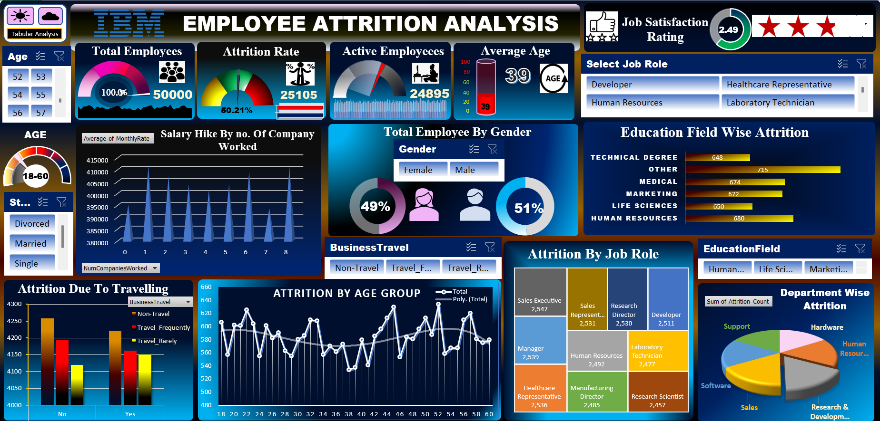
DASHBOARD
Click Here To Go To Dashboard

Slide 13

Conclusion: Retention Strategies
Key Findings
Recommendations
Summary of the main drivers behind employee attrition.
Data-driven strategies for improving employee retention.
Next Steps
Implementing a proactive retention program at IBM.

Slide 14
Thank You…

Slide 15

Thank
You…

